Slide 1
Introduction
Title: HR Analytics Dashboard in Power BI
Subtitle: Analyzing Employee Attrition and Key HR Metrics
Presented by: [Gaurav]

Slide 2
What is HR Analytics? HR Analytics helps organizations make data-driven decisions regarding employee management. Objective of the Project: Identify attrition trends and key factors affecting employee retention. Provide insights to improve workforce planning.

Slide 3
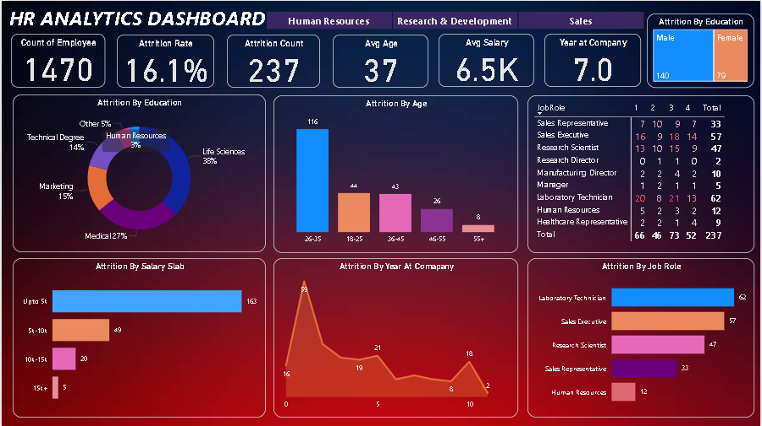

Slide 4
Key Insights from Dashboard - Attrition Analysis Attrition Rate: 16.1% Attrition by Education: Higher attrition in technical and marketing roles. Attrition by Age Group: Younger employees (26-35) have the highest attrition rate.

Slide 5
Departmental Insights Attrition by Department: HR: 12 employees Research & Development: 57 employees Sales: 62 employees Sales has the highest attrition rate.

Slide 6
Job Role Analysis Top Job Roles with High Attrition: Laboratory Technician: 62 Sales Executive: 57 Research Scientist: 47

Slide 7
Power BI Features Used Visualizations Used: Pie charts, bar graphs, and line charts. Filters Applied: Gender, department, job roles, years of experience. Challenges & Learnings Challenges Faced: Data cleaning and structuring. Selecting the right visualizations.

Slide 8
Conclusion & Recommendations: High attrition in Sales and R&D. Younger employees and lower salary groups are more likely to leave. Recommendations: Improve employee engagement and benefits. Offer better career progression paths.

Slide 9
Thank you
Gaurav
971107364
panwargaurav813@gmail.com

